Slide 1


Effective Board Governance
September 19, 2024
Christel C. Slaughter, PhD
www.consultssa.com

Slide 2
Characteristics of Great Boards

Slide 3
1. Understand Their Role and Responsibilities
Great boards have members who are clear about their role and their responsibilities to the organization. They know they are there as directors, rather than an executive team, and are committed to fulfilling their legal duties.
There is a clear understanding of the authority that lies with the board, and what has been delegated to board committees or staff.

Slide 4
2. Lead Strategically and
Support the Executive Director
The most important task for a board is to choose the organization’s Executive Director. Having the right person in this key role is vital for organizational success.
They know the difference between strategy and operations and stay much more in the strategic realm. That’s not to say they don’t oversee performance. However, great boards really focus on strategy and policy areas, and are confident that the staff have the abilities, aptitudes, and delegated authority needed to ensure operations run smoothly.

Slide 5
3. Commit to Ongoing Learning
There is no doubt that the best boards are those that are committed to ongoing development of their own members, both as individuals and as a team.
Mandatory annual training and documents to be familiar with include the bylaws, emergency operations manual, employee handbook/policies and procedures, strategic plan, and annual budgets.

Slide 6
4. Get the Right Information at Board Meetings
Great boards know what information they need to make decisions, and insist on getting it in the right format, and at the right time.
They ensure that the senior management team develops a robust reporting framework, and make sure information presented is accurate, complete, focused, and understandable.

Slide 7
5. Work as a Team
They have a clear sense of shared purpose, even when they have healthy disagreements about the best course of action.
Knowing that fellow board members have the best interests of the organization at heart leads to a culture of respect and team spirit among board members.
They also know that the Executive Director and staff are critical members of the organizational team.

Slide 8

’

Slide 9
6. Understand the Open Meetings Law and Proper Conduct Before and During Public Meetings
The board’s conduct sets the tone for the rest of the agency.
Great boards understand what can be considered a “walking quorum” and the problems with “polling” the board.
They understand the need for processes and protocols for meeting preparation including compliance with public notification laws requiring timely and postings in certain places, recommending agenda items, and communications with senior staff regarding questions about agenda items.
LLA Open Meetings Law
https://app.lla.state.la.us/llala.nsf/baadb2991272084786257ab8006ee827/$file/open%20meetings%20law%20faq.pdf

Slide 10
7. Understand Public Records Laws
Great boards understand the concept of allowing the public “unfettered access” to public documents – this can include emails, texts, etc.
LLA Open Meetings Law
https://app.lla.state.la.us/llala.nsf/7C469838E7BC1C5186257AC2004F6279/$FILE/Public%20Records%20Law%20FAQ.pdf

Slide 11
8. Understand the Public Bid Law
Great boards understand the importance of following proper RFP/RFQ protocols.
They always follow the stricter law to ensure a competitive process and successful reimbursement when considering procurement, especially after a disaster.

Slide 12
9. Understands the Louisiana State Civil Service System’s Relationship with the LHC
What can and cannot be done from a legal and ethical standpoint with regard to LHC employees.

Slide 13
Your Role and Responsibilities

Slide 14
Conduct Yourself with
Incredible Integrity
Act in the institution’s best interests, putting it ahead of your personal preferences and political allegiances. Regardless of how you were selected, as a board member you do not “represent” a particular group of constituents.
Preemptively disclose conflicts – actual and perceived – and dualities of interest. As a member of the board, err on the side of disclosing more – rather than less – information and then step aside from voting and, sometimes, discussions.
Uphold the highest ethical standards. Model the values, ethics, and morals that the board expects of the administration and staff.

Slide 15
Respect the Difference between the Board’s Role and the Executive Director’s Role
This principle supports the fundamental function of understanding governance by defining how the board and the Executive Director should work collaboratively toward a common vision. In order to embrace shared governance, you must:
  Be humble and respect your partners in governance and leadership. Use your position to better understand others’ perspectives and take them into account.
  Provide advice and counsel but leave operational decisions to the administration. Serve as a thought partner, sounding board, and pro bono advisor by sharing your relevant expertise and experience.

Slide 16
Think Independently and Act Collectively
Think for yourself, reach your own conclusions, and share your perspective productively.
Speak up on important issues, even if they are uncomfortable or unpopular. The board and organization lose out – or may even be put at risk – when directors remain silent.
Express your concerns diplomatically to the appropriate person(s) at an appropriate time. Be intentional about what you communicate, how, when, where, and to whom.

Slide 17
Ask Yourself…
Is our performance as a team (board/management/staff) going to attract businesses and residents who want to locate to, live in, and contribute to the overall success of Louisiana?

Slide 18
The Three Duties of a Fiduciary

Slide 19
Duty of Care
The obligation to provide the level of care that an ordinarily prudent person would exercise in a similar position and under similar circumstances
Being interested in, and informed about, the organization’s mission, goals, and plans
Preparation before board and committee meetings (e.g., reviewing agenda, reports, etc.)
Active participation in meetings
Remaining alert to potential concerns and problems
Asking for more information (e.g., from management, accountants, attorneys, etc.) before making decisions
Investigating irregularities and/or violations in governance of
the organization

Slide 20
Duty of Loyalty
The duty of loyalty revolves primarily around board members’ financial self-interest and the potential conflict this can create. When a board member is making decisions affecting the organization, the organization must have their undivided allegiance.
This means not only in decision-making on behalf of the organization, but also that a board member may never use information obtained as a member for personal gain. Rather, they must act in the best interest of the organization.
Every board member’s compliance with the organization’s policy surrounding conflicts of interest starts with full disclosure of any potential conflicts, to avoid the appearance of impropriety.
When a conflict of interest does arise, the affected director has an obligation to recuse himself or herself from participating in the discussion and/or decision.

Slide 21
Duty of Obedience
The duty of obedience is about respecting the limits of the board’s power and using that power to help the organization fulfill its mission — while also respecting and obeying the law. The flip side of this is that board members must not act inconsistently with the organization’s mission.
In other words, directors have a duty to make decisions that serve the purpose of upholding and perpetuating the organization’s mission – guiding decision-making to help keep the organization on course toward its stated objectives.
Board members need to be ready to question initiatives, investments, or other plans that could degrade or derail
the mission.

Slide 22
What is a Fiduciary?
The term “fiduciary” has its origins in the Latin, fudiciarius, denoting the importance of trust and confidence in the
fiduciary relationship.
In short, a fiduciary is a person who acts on behalf of someone or something else, whether an individual, a citizen, or a tax payor,
for example.

Slide 23
Role of the
CEO
Representing the organization in negotiations and public events
Maintaining regulatory liaisons
Hiring, directing, educating, evaluating, and disciplining staff
Preparing the annual budget and managing finances
Overseeing staff and programs
Planning operations consistent with the board’s long-term plan
Reporting to the board on programs
and operations
Staying abreast of new developments and keeping the board up-to-date
Remaining current on appropriate
management operations
Monitoring compliance with federal, state, and local laws/program rules

Slide 24
Seems Pretty Simple, Right?
The slippery slope
of complacency…

Slide 25

Deadly Sin No. 1
Over-Reliance on Treasurer or
Finance Committee
Understand your financial statement
Ask questions when you
don’t understand
Ask for a one-on-one session
if needed
No question is “too dumb”
REMEMBER you are accountable
to the taxpayers

Slide 26
Deadly Sin No. 2
Not Understanding
Conflicts of Interest
Hiring family members of board members
Service recipients serving as board members
Importance of transparency: purchasing goods or services from companies/non-profits owned or directed by board members

Slide 27

Deadly Sin No. 3
Allowing One Board Member to Dominate
This is a BOARD problem – don’t expect staff to handle!
Should fall to the board Chair
If they are destructive, they should be asked to step down

Slide 28
Responding to Public Pushback
A community member cornered a board member at the local supermarket to complain about a recent controversial board decision that made the front page of the newspaper.
The board member responded, “Thanks for your concern. I’ll share this with the president and the board.” The board had agonized over the issue and the vote was not unanimous, but board members all agreed that the process had been thorough.
Rather than being defensive or off-putting, this board member listened and responded without making any promises on behalf of the organization. He also sent a quick note to
the board Chair to let them know about
this encounter.

Slide 29
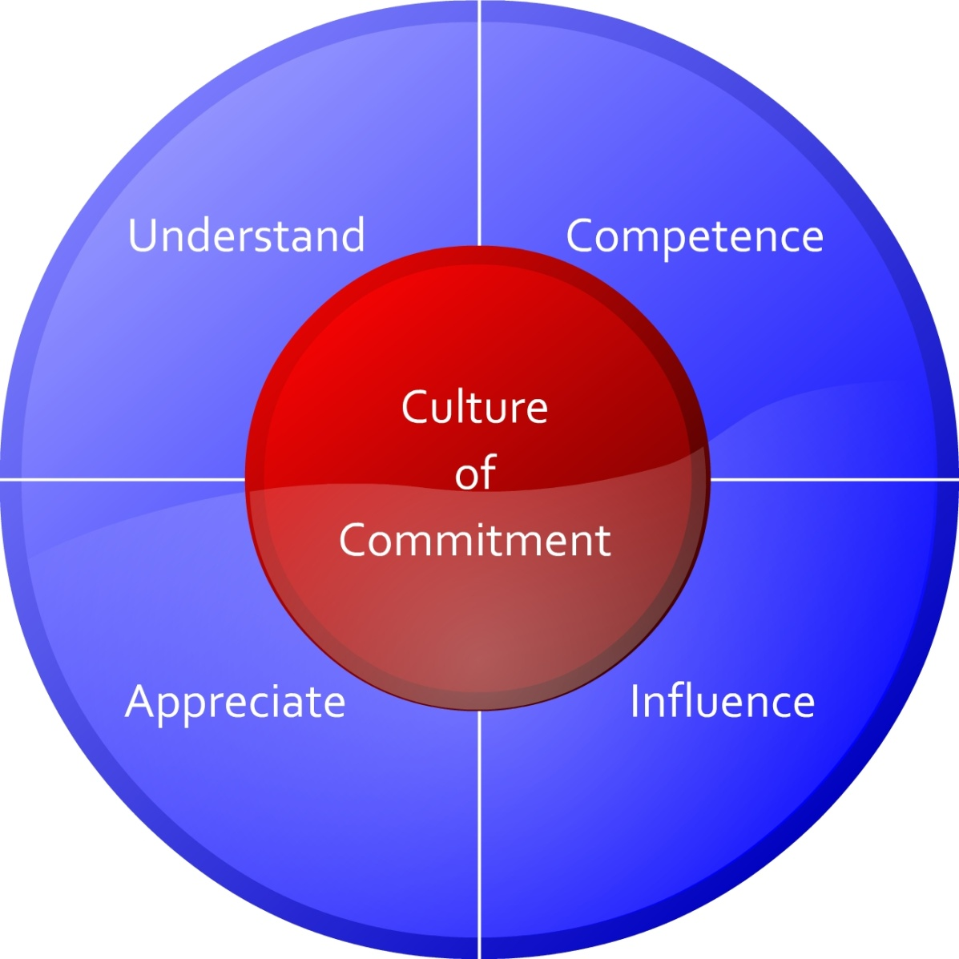
The Commitment Model

